Slide 1
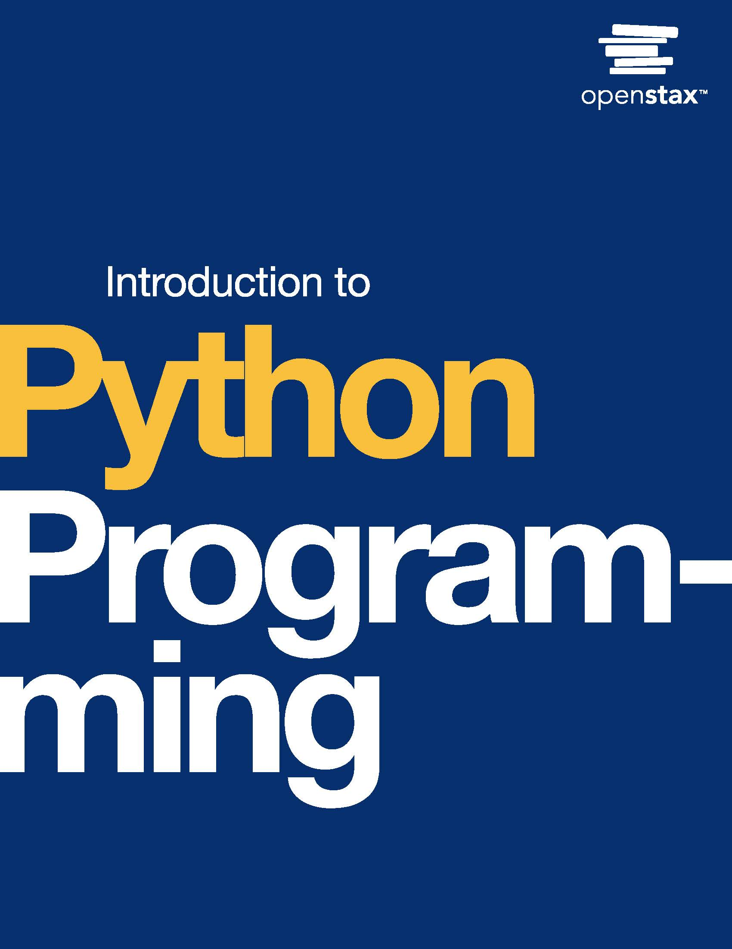
Introduction to Python Programming
Chapter 3: Objects

Slide 2
Chapter outline
Strings revisited
Formatted strings
Variables revisited
List basics
Tuple basics

Slide 3

Figure 3.1
credit: modification of work "Port of Melbourne", by Chris Phutully/Flickr, CC BY 2.0
Notes:
shipping containers at a port

Slide 4
3.1 Strings revisited
Learning Objectives
Extract a specific character from a string using an index.
Use escape sequences to represent special characters.

Slide 5
3.1 Strings revisited
Indexes
A string is a sequence of zero or more characters. Each character has an index that refers to the character's position. Indexes are numbered from left to right, starting at 0. Indexes are also numbered from right to left, starting at -1.

Slide 6
3.1 Strings revisited
Unicode
Unicode defines a unique number, called a code point, for each possible character.
Ex: "P" has the code point 80, and "!" has the code point 33.
The built-in ord() function converts a character to a code point.
Ex: ord("P") returns the integer 80. Similarly, the built-in chr() function converts a code point to a character. Ex: chr(33) returns the string "!".
Unicode is an extension of ASCII, the American Standard Code for Information Interchange.
Originally, ASCII defined only 128 code points, enough to support the English language.
Unicode defines over one million code points and supports most of the world's written languages.

Slide 7
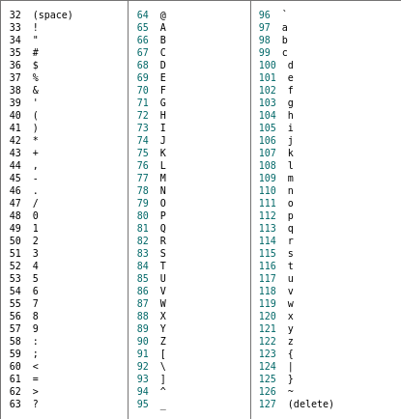
Table 3.1 Character values.

Slide 8
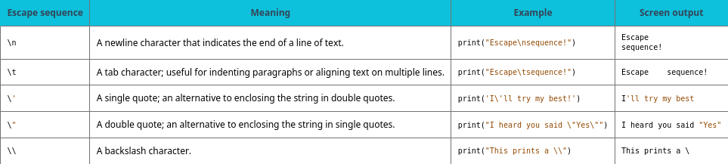
Table 3.2 Common escape sequences.

Slide 9
3.2 Formatted strings
Learning Objectives
Use f-strings to simplify output with multiple values.
Format numbers with leading zeros and fixed precision.

Slide 10
3.2 Formatted strings
F-strings
A formatted string literal (or f-string) is a string literal that is prefixed with "f" or "F".
A replacement field is an expression in curly braces ({}) inside an f-string. Ex: The string f"Good morning, {first} {last}!" has two replacement fields: one for a first name, and one for a last name. F-strings provide a convenient way to combine multiple values into one string.

Slide 11
3.2 Formatted strings
Formatting numbers
Programs often need to display numbers in a specific format.
Ex: When displaying the time, minutes are formatted as two-digit integers. If the hour is 9 and the minute is 5, then the time is "9:05" (not "9:5").
In an f-string, a replacement field may include a format specifier introduced by a colon.
A format specifier defines how a value should be formatted for display. Ex: In the string f"{hour}:{minute:02d}", the format specifier for minute is 02d.

Slide 12
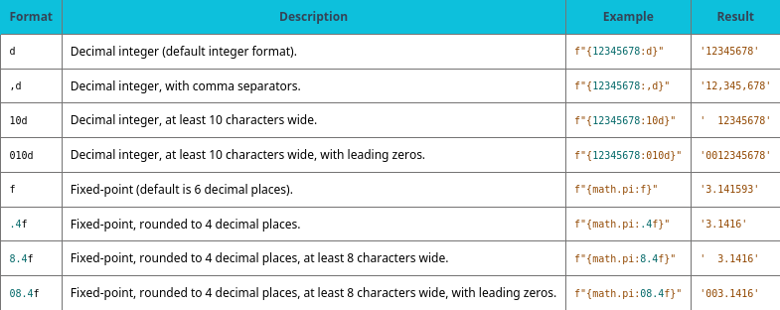
Table 3.3 Example format specifiers.

Slide 13
3.3 Variables revisited
Learning Objectives
Distinguish between variables, objects, and references.
Draw memory diagrams with integers, floats, and strings.

Slide 14
3.3 Variables revisited
Properties of objects
Every object has an identity, a type, and a value:
An object's identity is a unique integer associated with the object.
Once created, an object's identity never changes.
The built-in id() function returns the object's identity.
An object's type determines the possible values and operations of an object. Ex: Integers and floats can be "divided" using the / operator, but strings cannot. The built-in type() function returns the object's type.
An object's value represents the current state of the object. Many objects, such as numbers and strings, cannot be modified once created. Some objects, such as lists (introduced later), are designed to be modified.

Slide 15
3.3 Variables revisited
Properties of objects
An object's type determines the possible values and operations of an object.
Ex: Integers and floats can be "divided" using the / operator, but strings cannot. The built-in type() function returns the object's type.
An object's value represents the current state of the object.
Many objects, such as numbers and strings, cannot be modified once created.
Some objects, such as lists (introduced later), are designed to be modified.

Slide 16
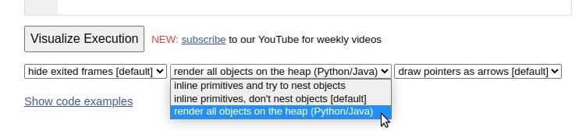
Figure 3.2
Screenshot of Python tutor settings, with the middle dropdown list open to the last setting.
Notes:
Screenshot of Python tutor settings, with the middle dropdown list open to the last setting.

Slide 17
3.4 List basics
Learning Objectives
Use indexes to access individual elements in a list.
Use indexes to modify individual elements in a list.
Use len() function to find the length of a list.
Demonstrate that lists can be changed after creation.

Slide 18
3.4 List basics
Lists
A list object can be used to bundle elements together in Python. A list is defined by using square brackets [] with comma separated values within the square brackets. Ex: list_1 = [1, 2, 4].
Empty lists can be defined in two ways:
list_1 = []
list_1 = list()
Lists can be made of elements of any type: integers, strings, floats, or any other type.
Lists can also contain a combination of types. Ex: [2, "Hello", 2.5] is a valid list.

Slide 19
3.5 Tuple basics
Learning Objectives
Describe the features and benefits of a tuple.
Develop a program that creates and uses a tuple successfully.
Identify and discuss the mutability of a tuple.

Slide 20
3.5 Tuple basics
Creating tuples and accessing elements
A tuple is a sequence of comma separated values that can contain elements of different types.
A tuple must be created with commas between values, and conventionally the sequence is surrounded by parentheses.
Each element is accessed by index, starting with the first element at index 0.

Slide 21
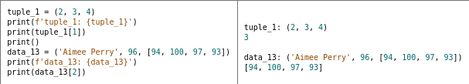
Table 3.4 Example tuples.

Slide 22
3.5 Tuple basics
Tuple properties
Tuples are ordered and allow duplicates, like lists, but have different mutability.
An immutable object cannot be modified after creation.
A mutable object can be modified after creation. Tuples are immutable, whereas lists are mutable.

Slide 23
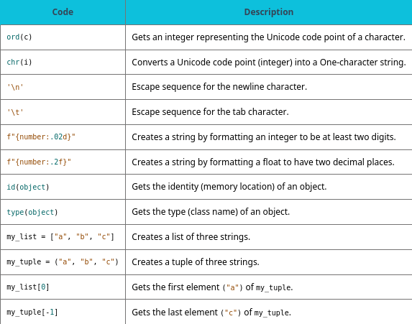
Table 3.5 Chapter 3 reference.

Slide 24
This ancillary resource is licensed under a Creative Commons Attribution-NonCommercial-ShareAlike 4.0 (CC BY NC-SA) license; it may be distributed, remixed, built upon for noncommercial purposes only, and must be attributed to OpenStax and redistributed under the same license.

